Slide 1
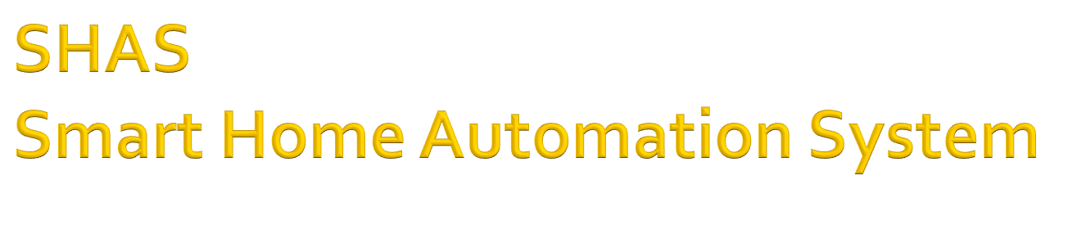
Team Beta

Slide 2

To design and develop a Smart Home Automation System (SHAS).
To monitor and optimize the energy consumption of the home.
Ensure the house is safe by monitoring the home.

Slide 3

The System would monitor the smart enabled home appliances
The SHAS system would monitor smart appliances and intimate the owner using a web browser and iPhone user interface.
The SHAS system would monitor the air conditioner, water heater, lighting, doors and windows, sprinkler system, detector, washer/dryer, dishwasher and power outlets.

Slide 4
As the scope of the project is big, the scope has been trimmed down and split as phases and for this semester we would be doing implementing phase 1.
Each phase would achieve a part of the application.
After every phase, the system will remain functional and will have enhancements and maintenance fixes.

Slide 5

As of phase 1, SHAS will be simulated using Java technology. Stubs will be provided in the system which will simulate a smart appliance.
This stub can be replaced by the actual smart device in the future phases.
The prototype will help in testing of the system under various conditions.

Slide 6

Phase 1 scope includes the following
Water Related:
  Water Heater
  Water meter
  Electric Related
  Lighting
  Electric meter
  Smart Power outlets

Slide 7

Police Alert System
Air Conditioning
Detectors
User Interfaces
iPhone app that allows the homeowners to easily have complete control of their home.
Web Browser

Slide 8
Phase 1 features have been chosen in a way to include most of the features as the design will be in a way to incorporate modifiability.

Slide 9

Phase 2 will include support for appliances as lawn sprinklers, dishwasher, washer/dryer, bath/shower, stove, windows/doors, security system.

Slide 10


